Slide 1




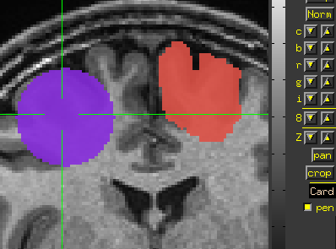
AFNI
Didactics and Demonstrations
Regions of Interest (ROIs)
Tools - Doing things with ROIs

Slide 2
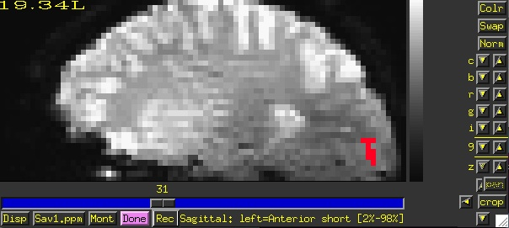
Looking at values inside the ROI
3dmaskave
This ROI program computes the average of voxels (usually from a functional or time-series dataset), that are selected from an ROI mask
Class Example:
3dmaskave -mask anat_roi_resam+orig -q \
rall_vr+orig > epi_avg.1D
The above command takes the voxels that fall within the ROI mask, and computes a mean for every time point/volume.
In this example, there are 450 time-points in this dataset, so the output will be a column of 450 means.
-q : Suppresses the voxel-count output (e.g., “[9 voxels] make up the ROI mask”) from appearing next to each mean.
Alternatively, instead of having the results of 3dmaskave spewed into the shell, you can redirect ( > ) the results into a text file (epi_avg.1D) and save them for later use.

Slide 3
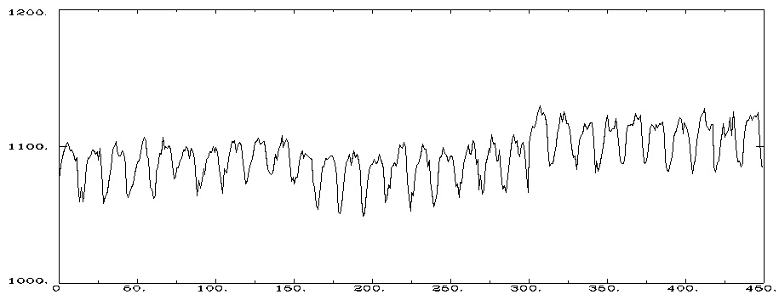
1076.11 1086.11 1092.33
1097.33
...
1084.76
Output will look like this (450 means in the column):
less epi_avg.1D
Data can also be plotted out using 1dplot:
1dplot epi_avg.1D or…
1dplot -yaxis 1000:1200:2:1 epi_avg.1D
Mean voxel intensity for voxels falling within the ROI mask (at each timepoint).
3 concatenated EPI runs, Timepoints (0-449)

Slide 4
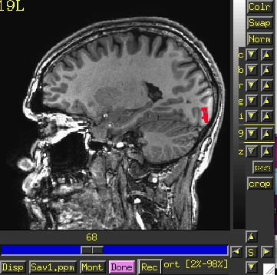
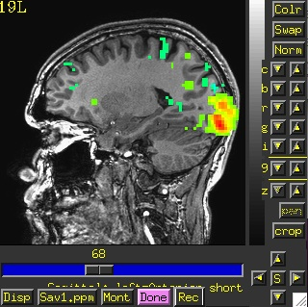
3dmaskdump
Program that dumps out all voxel values in a dataset inside the mask ROI
Class example:
3dmaskdump -noijk -mask anat_roi_resam+orig \
'func_slim+orig[2]' > Vrel-tstats.txt
The output appears in the shell (unless you redirect it ‘>’ into a text file). This example shows one column of numbers, representing the voxel values for functional sub-brick #2 (‘Visual-reliable’ t-values) that fall within the ROI mask:
Dump out the voxel values from the functional dataset, sub-brick #2, but only for those voxels that fall within the ROI mask.
3dUndump can do the opposite – take a text file (ijk/xyz and values) to make a dataset

Slide 5
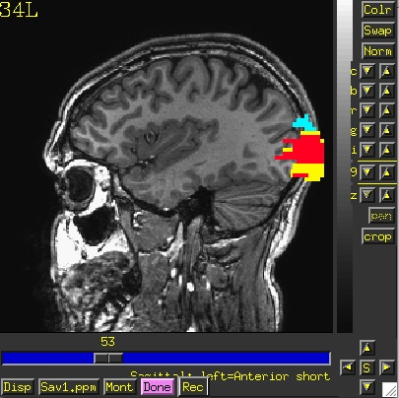
3dROIstats
Program to compute separate statistics for each ROI in a dataset
Means, medians, std. devs., ... can be computed separately for multiple ROIs in the same dataset
Example:
3dROIstats -mask 3rois+orig func_slim+orig'[0]'
Output shown in the shell (use > command to save into to a text file):
File Sub-brick Mean_-1 Mean_1 Mean_2
func_slim+orig[0] 0[Full_Fsta] 10.805717 69.336539 71.333655
3rois+orig

Slide 6
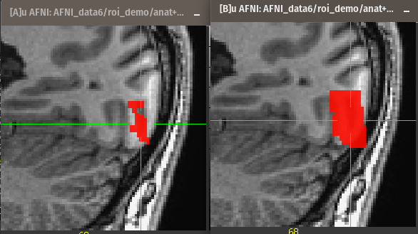
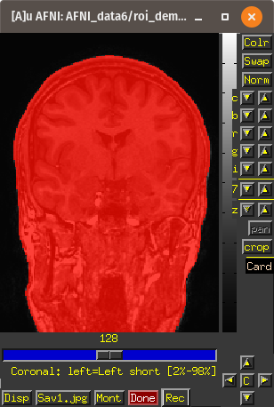
More tools for ROIs
3dmask_tool -prefix mask_dil3 -dilate_result 3 \
-inputs anat_roi+orig
3dAutomask -prefix anat_am anat+orig

Slide 7
whereami can provide the user with more detailed information regarding the output of 3dClusterize
  For instance, say you want more information regarding the center of mass voxels from each cluster (from the 3dclust output). I.e., where do they fall approximately within the atlases?
  3dClusterize -clust_nvox 200 -bisided -8.0 8.0 -ithr 2 -idat 1 -NN 1 -inset func_slim+orig. -quiet > visual_clusters.1D
  whereami -coord_file clusts.1D'[1,2,3]' -tab | less
++ Input coordinates orientation set by default rules to RAI
+++++++ nearby Atlas structures +++++++
Original input data coordinates in TLRC space
Focus point (LPI) Coord.Space
-3 mm [L], -83 mm [P], 2 mm [S] {TLRC}
-3 mm [L], -86 mm [P], -3 mm [I] {MNI}
-3 mm [L], -90 mm [P], 2 mm [S] {MNI_ANAT}
Atlas Within Label Prob. Code
TT_Daemon 0.0 Left Lingual Gyrus MPM 232
TT_Daemon 0.0 Left Brodmann area 18 MPM 295
TT_Daemon 1.0 Left Brodmann area 17 MPM 294
TT_Daemon 4.0 Left Cuneus MPM 240
TT_Daemon 4.0 Right Lingual Gyrus MPM 32
TT_Daemon 4.0 Right Brodmann area 18 MPM 95
TT_Daemon 5.0 Right Brodmann area 17 MPM 94
TT_Daemon 7.0 Right Cuneus MPM 40
CA_ML_18_MNIA 0.0 Left Calcarine Gyrus --- 43
CA_ML_18_MNIA 3.0 Left Lingual Gyrus --- 47
CA_ML_18_MNIA 7.0 Right Lingual Gyrus --- 48
CA_MPM_18_MNIA 0.0 Area 17 --- 181
CA_MPM_18_MNIA 1.0 Area 18 --- 240
Center of mass output, columns 1,2,3, from 3dClusterize, Clusterize plugin or 3dclust reports.
Shown: Cluster #1’s coordinates according to various atlases (TT, MNI, etc), as well as the name of the anatomical structure that is located at or near these coordinates (varying by atlas)

Slide 8
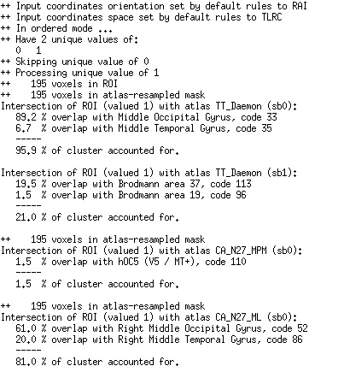
whereami can report on the overlap of ROIs with atlas-defined regions
    whereami -omask anat_roi+tlrc

Slide 9
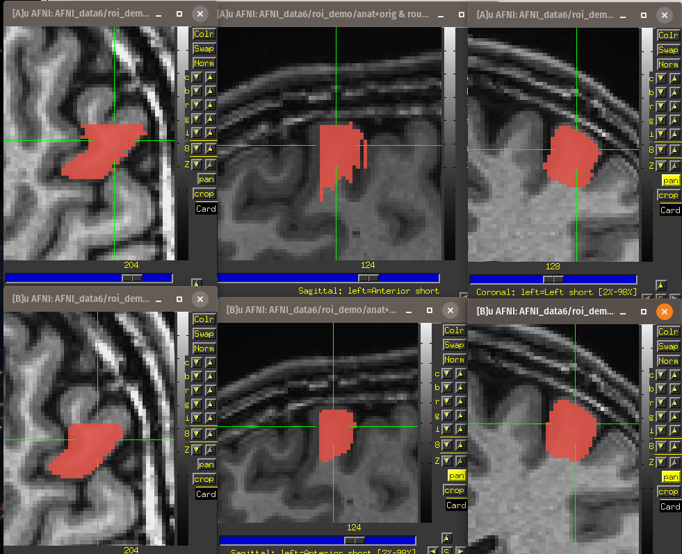
ROI irregularities - Modal smoothing
Original drawing
Smoothed
3dLocalstat -stat mode -prefix coronal_mode3 \
-nbhd 'SPHERE(3)' roughcoronalROI+orig.
3drefit -cmap INT_CMAP coronal_mode3+orig.

Slide 10
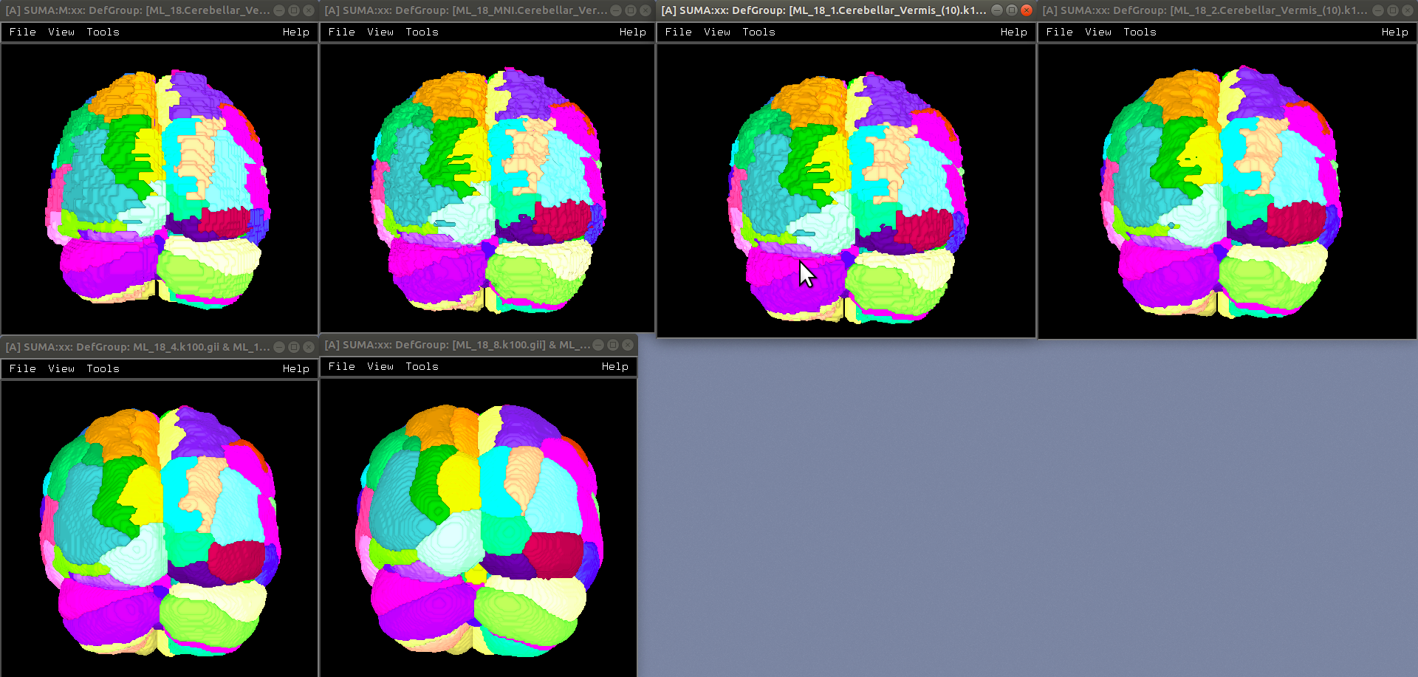
MacroLabel atlas - modal smoothing example
N27, MNI_2009c,1mm,2mm,
4mm,8mm

Slide 11
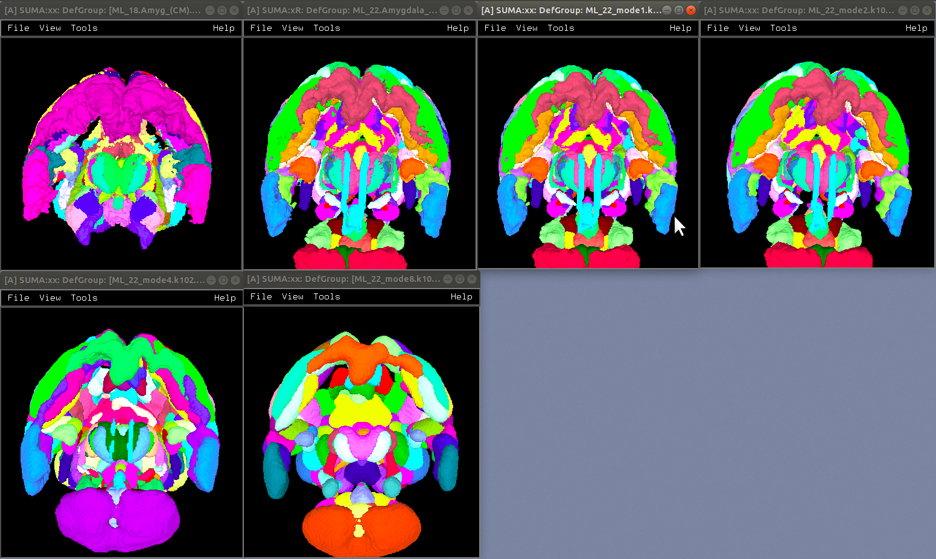
Eickhoff-Zilles MPM 2.2 atlas - modal smoothing example
1.8 version, 2.2 version, 1mm,2mm,4mm,8mm

Slide 12
Circularity – "double dipping"
Using results from one set of data to limit the data in that same set.
FMRI example:
Find largest differences with some threshold between groups A and B
Create ROIs from those differences
Show differences between ROIs for the same two groups showing that indeed A is very different from B with a p-value of 0.05. They're different because they're different.
Solution : Use ROIs from independent data: Atlas regions, locator tasks, other subjects

Slide 13
ROIs from Locator session day 1 applied to session day 2 EPI
Session 1 – Locator Task
Session 2 - Task
structural-functional alignment from align_epi_anat.py
(affine)
structural-functional alignment from align_epi_anat.py
(affine)
Anat1
Anat2
Freesurfer
Seg. (Atlas)
Locator
TR=0
Locator
TR=1
...
Locator
TR=n
EPI_RUN1
TR=0
EPI_RUN1
TR=1
...
EPI_RUN1
TR=n
motion correction xforms from 3dvolreg
cluster
ROI 1
cluster
ROI 2
...
cluster
ROI m
EPI_RUN2
TR=0
EPI_RUN2
TR=1
...
EPI_RUN2
TR=n
motion correction xforms from 3dvolreg
align_epi_anat a2 to e2 => a2e2.aff12.1D
align_epi_anat a1 to a2 => a1a2.aff12.1D
align_epi_anat L1 to a1 => L1a1.aff12.1D
cat_matvec a2e2.aff12.1D a1a2.aff12.1D L1a1.aff12.1D > L1e2.aff12.1D
3dAllineate -1Dmatrix_apply L1e2.aff12.1D –final NN –prefix ROI1_e2 \
-base epi_run1+orig'[1]' –input ROI1+orig
e2 -> a2
a2 -> a1
a1 -> L1
e2 -> L1
Known or User-defined transformations
Resource
Transformation
Dataset
Same space / Identity xform

Slide 14


That’s All for Now

